Slide 1



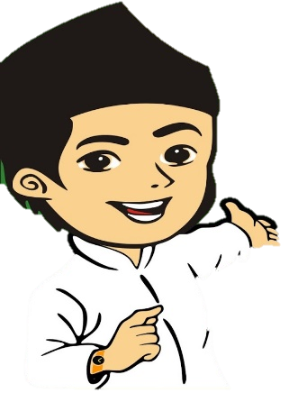


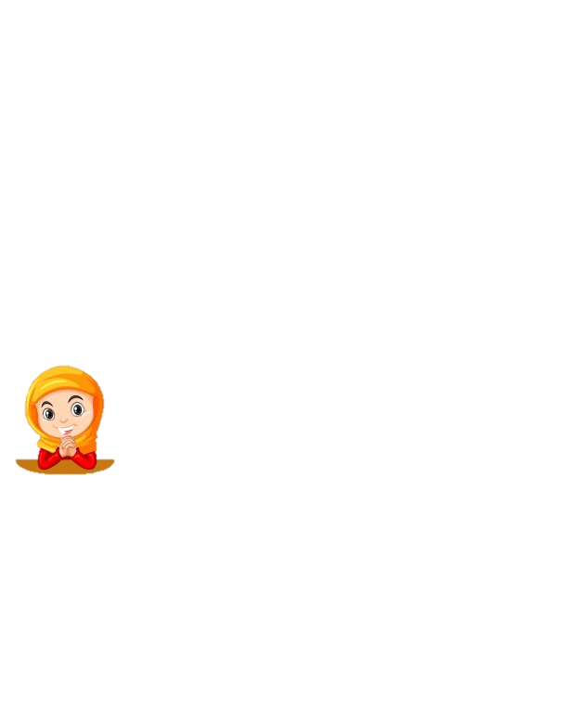
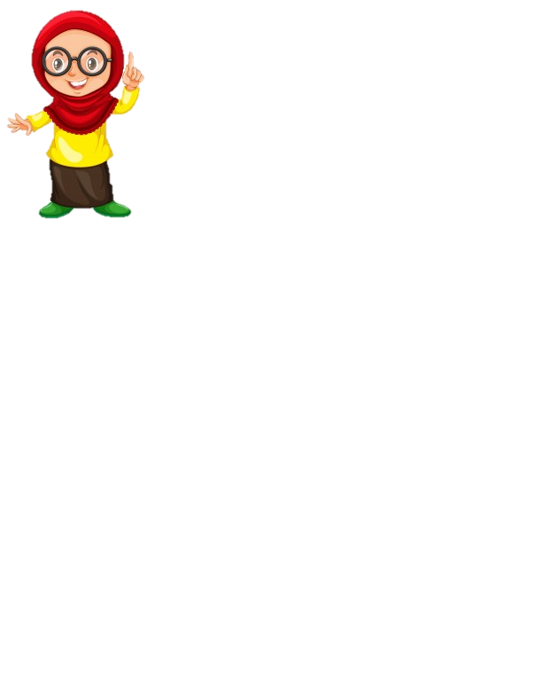
Detection Of Hijab Syar'i As Smart Clothes System For Moslem People Using High Performance Of Parallel Computing
Author:
Imam Cholissodin | imamcs@ub.ac.id^{1,}* Ditya Enandini Palupi², Muhammad Yudha Yusi Putra³, Shinta Aprilisia⁴
Faculty of Computer Science, Universitas Brawijaya
10th ICGT, October 2 - 3 2019 @ Savana Hotel & Convention Malang, Indonesia

Slide 2


Introduction
In today's millennial era and forever, Moslems are required to remain consistent in using shar'i clothing.
But sometimes someone is feel difficult to distinguish between syar'i clothes and those that are not syar'i.
Based on current technological developments, distinguishing any object can be done through detection techniques using digital image processing.
But digital image processing requires very long time-processing and ineffective processing (CPU) alone is not enough.
This study using how to speed up performance analysis to digital image through Graphics Processing Unit (GPU).
2
Notes:
Condition of Saudi Arabia

Slide 3

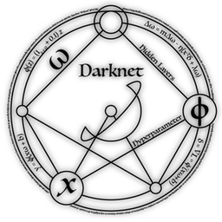
Introduction
Yolo v3 Algorithm
implement
Advantages
Allow parallel programming to use GPU resources and can perform the object detection process quickly and accurately by applying an artificial neural network algorithm to detection of hijab syar'i as smart clothes for Muslim women.
So that the user as a Moslem is able to identify independently and as an evaluation automation combined with the help of the implementation of the detection.
The test results achieve good detection, prove that by using implementation Yolo Darknet under GPU to recognize the hijab syar'i is good to development.
Build of Intelligence System Using GPU NVIDIA CUDA
On
Google Colaboratory
3

Slide 4
Method
Yolo v3 Algorithm
You Only Look Once (Yolo) Darknet (darknet means that so many hidden layer that used on algorithm) is a state-of-the-art unified for object detection system as real time, that first propose by Joseph Chat Redmon et. al.
Yolo v3 change Loss Function of loss function Yolo v2 on Equation (1) below with logistic regression approach.
(1)
4

Slide 5




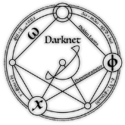
Design and Implementation
Software and Hardware specification:
Google Colaboratory (Jupyter Notebook)
Ubuntu 18.04.3 LTS, with HDD ± 300GB RAM 12GB
GPU NVIDIA Tesla K80 & cudnn-10.0-linux-x64-v7.5.0.56.tgz
Processor Intel(R) Xeon(R) CPU @ 2.30GHz
Snippet code to training & testing (python script):
!./darknet detector train "/content/drive/My Drive/darknet/obj.data" "/content/drive/My \ Drive/darknet/cfg/yolov3.cfg" "/content/drive/My \ Drive/darknet/weights/darknet53.conv.74" -dont_show
!./darknet detector test "/content/drive/My Drive/darknet/obj.data" \ "/content/drive/My Drive/darknet/cfg/yolov3.cfg" "/content/drive/My \ Drive/darknet/backup/yolov3_2000.weights" "/content/drive/My \ Drive/darknet/testImgFamily/f1.jpg" -thresh 0.85 -dont-show
5

Slide 6
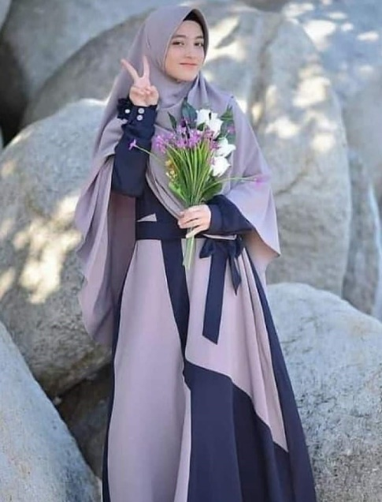
Design and Implementation
Stages to detection hijab syar'i
For example here this to data annotation
157px
126px
<object-class-id> <center-x> <center-y> <width> <height>
1044px
center-x = x / W = 390 / 796
center-y = y / H = 90 / 1044
width = w / W = 126 / 796
height = h / H = 157 / 1044
Where (in pixels)
x,y is center of bounding box
w is width of bounding box
h is height of bounding box
W is width of the whole image
H is height of the whole image
796px
6

Slide 7
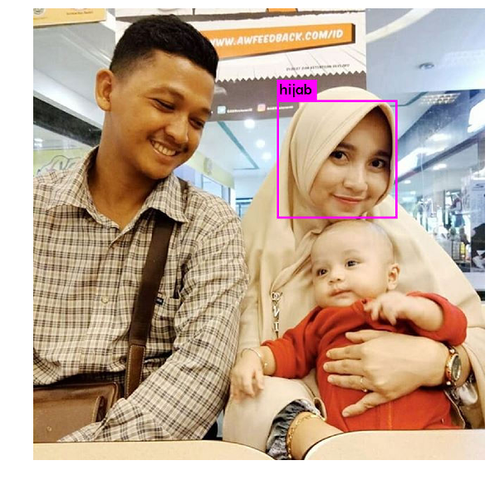
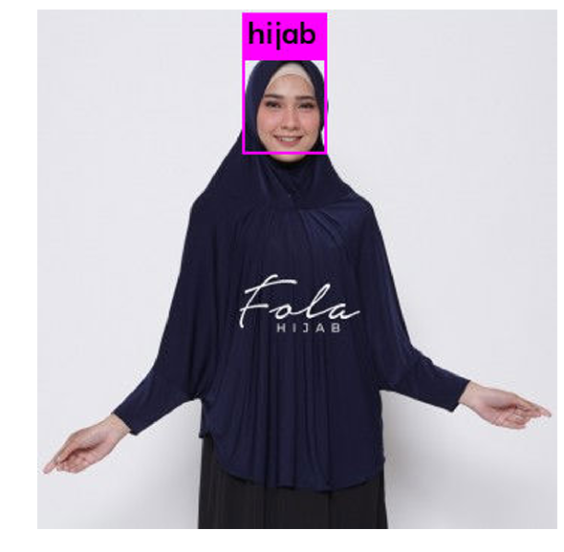
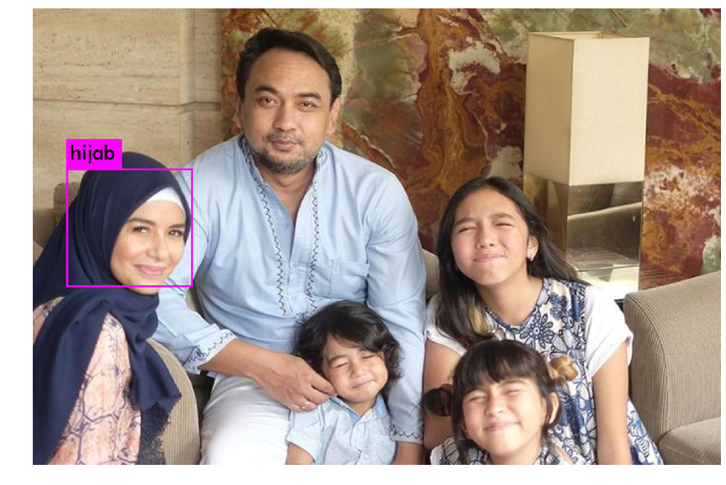
Results of Testing
Testing with Variation data:
(c)
(a)
(b)
Result detection a mother using hijab at photo family with complex condition, where the part of member’s family not using hijab (husband) and with the children. The system can be done to detect, not base on face detection, but can be good detection only person that wearing hijab.
Other result good detection hijab to only a mother with the baby, besides husband.
And result detection selt muslim women that selfie photo.
7

Slide 8
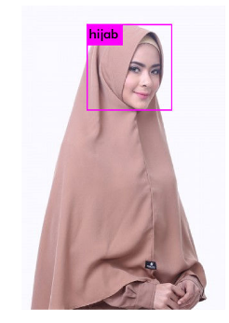
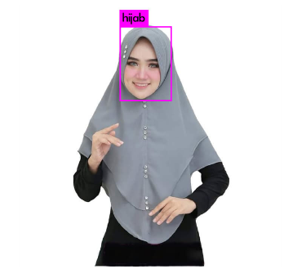
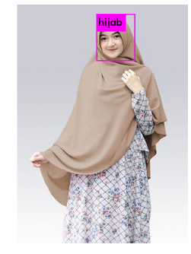
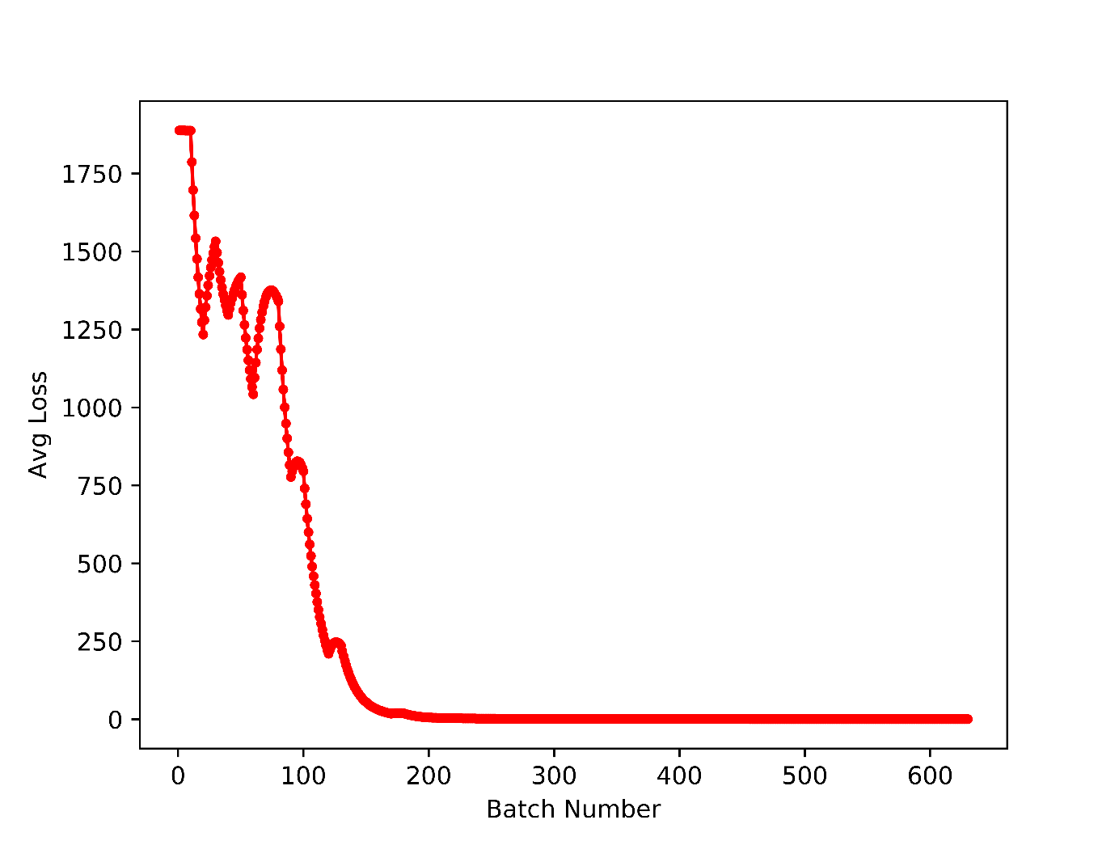
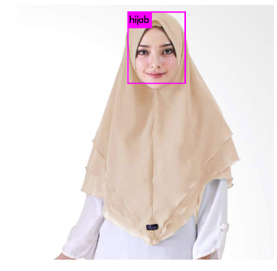
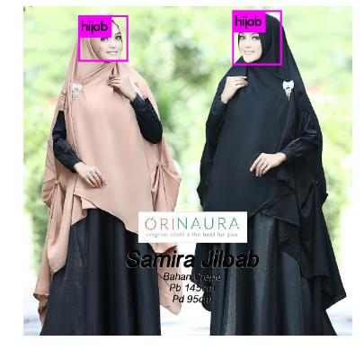
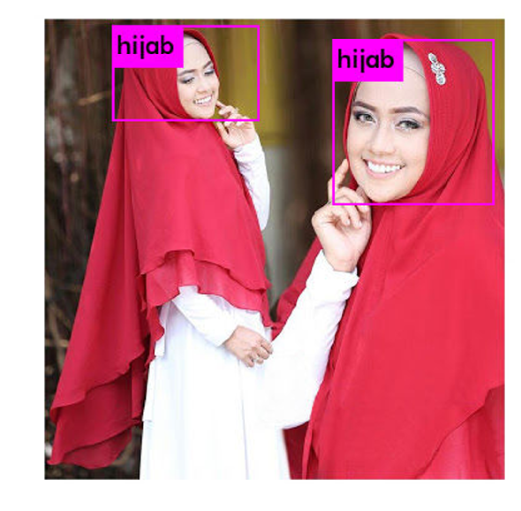
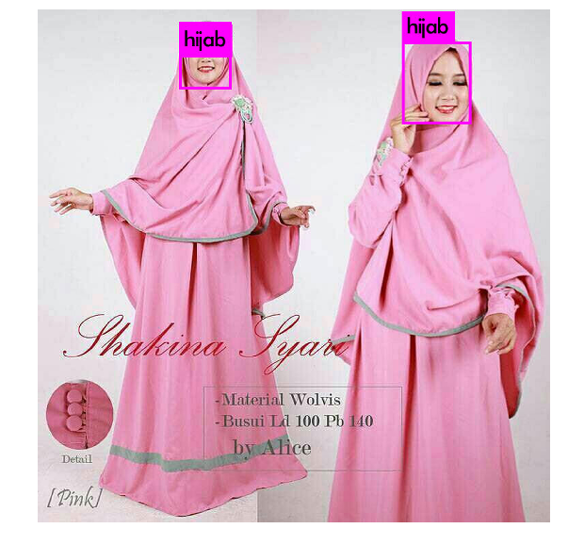
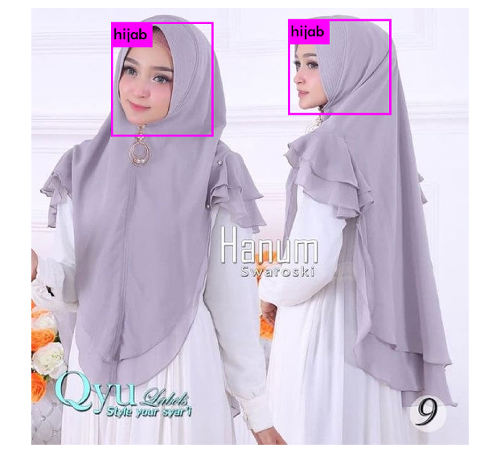
Results of Testing
Loss Average value can be call as error rate, for trainign process can be achieve ideal resul of training if the the Loss average with the increasing iteration or Batch Number, then the value toward convergence to zero like base on Figure below.
Loss average (convergence )
Others results of testing
8

Slide 9
Conclusions & Future Works
Detection of Hijab shar’i proved and can be implement also have been done using GPU NVIDIA CUDA and Yolo v3 algorithm with optimal result.
From result of performation detection of hijab give average train loss toward the convergence condition.
Provide more complex and complete dataset of hijab and many variant (many model, style, position and so on).
Improve implementation to real time, interactive or streaming processing on mobile App and others as Final Product.
Optimization parameter and using Particle Swarm Optimization (PSO) or Genetic Algorithm (GA) or other algorithm from Swarm Intelligence and Evolution Algorithm.
9

Slide 10
Thank You
Author:
Imam Cholissodin | imamcs@ub.ac.id^{1,}* Ditya Enandini Palupi², Muhammad Yudha Yusi Putra³, Shinta Aprilisia⁴
Faculty of Computer Science, Universitas Brawijaya
10th ICGT, October 2 - 3 2019 @ Savana Hotel & Convention Malang, Indonesia

